Slide 1
Simulation Product Line Sprint 1

Slide 2
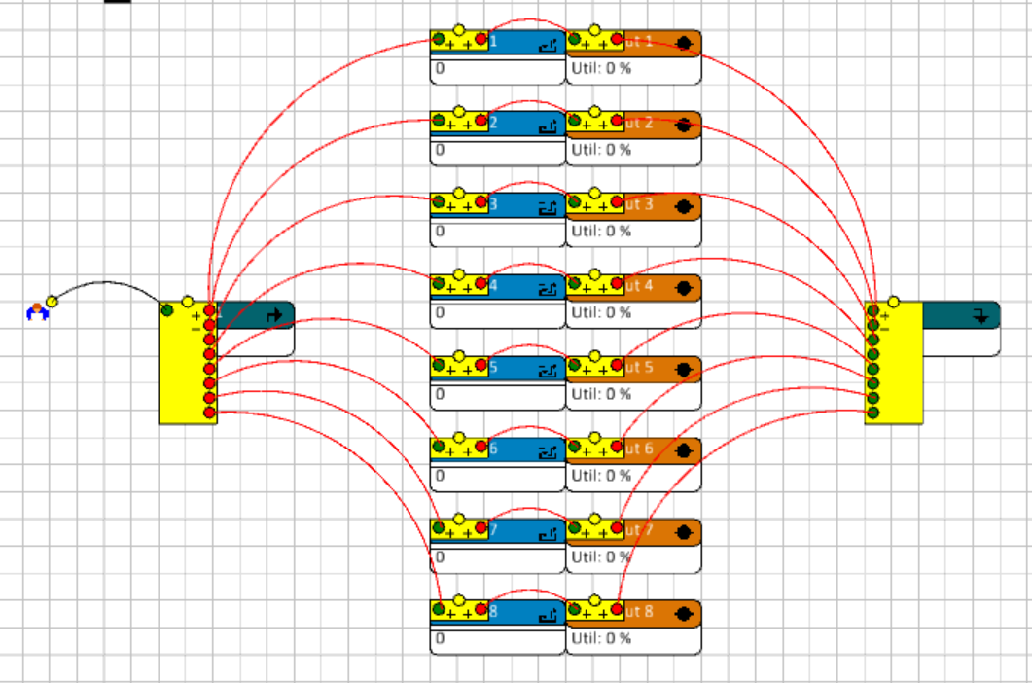
Progress
Tutorial Enterprise Dynamics
Use Case 1 : The production line
Standard complete
Strategy 1 complete
Strategy 2 complete
Use Case 2 : The supermarket
Strategy 1 complete
Strategy 2 in progress

Slide 3
Results
Scenarios | Week production
Standard | 95,98
Reduced Repair | 109,39
Buffer | 105,99
Basic modeling nodes
Stochastic processes (random probability distribution)
Discrete and continuous distribution
Channel flows
4dScripts
Experiments
Setup
Result reading
Avg Checkout usage (%) | Avg Checkout stay (sec) | Avg Queue length (cstmrs) | Avg Queue stay (sec)
92.13 | 149.94 | 1.74 | 277.32

